Slide 1

Introduction to IBM Copy Services Manager (CSM) 6.3.13
Overview and Use Cases
Notes:
'll help you analyze the content in your document. This appears to be a draft of an instructor transcript for teaching IBM Copy Services Manager (CSM) 6.3.13.
Based on my review, the document is structured as a lecture-style educational material with:
An introduction explaining the purpose of the document
Lesson 1 covering an overview of IBM CSM 6.3.13
Three pages of content covering:
Product overview and use cases
Key components (Management Server, Storage Systems, Host Systems)
Interface options (GUI, CLI, and API Integration)
Each section includes:
Concept explanations (marked with 📢)
Real-world examples and use cases (marked with 💡)
Best practices (marked with 📌)
Practical examples for hands-on activities
The content appears to be well-organized for teaching purposes, with a good mix of theoretical knowledge and practical applications. The transcript includes specific examples of how different industries (financial, retail, airline, etc.) might use CSM for disaster recovery, data migration, and high availability systems.
Would you like me to provide feedback on this instructor transcript, expand on any particular section, or help develop additional content for this training material?

Slide 2
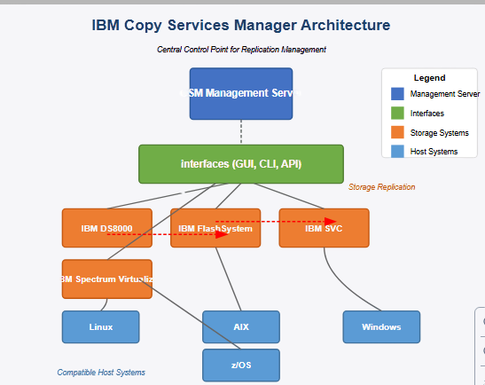

Slide 3
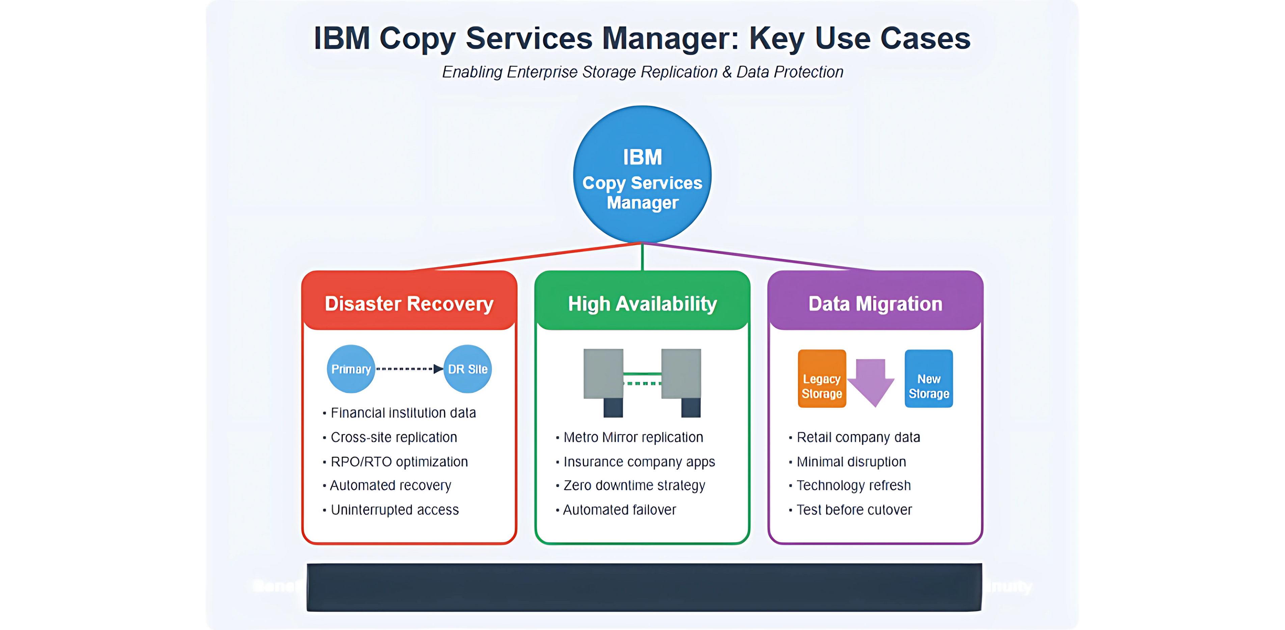
Benefits: Reduced Risk⚫ Simplified Management Automated Recovery ⚫ Business Continuity
Notes:
This diagram illustrates the architecture of IBM Copy Services Manager (CSM) and how it integrates with various storage systems and host environments. The key components shown are:
CSM Management Server (blue, top center)
Acts as the central control point for managing replication sessions
Handles authentication, access control, and configuration settings
Interfaces (green, middle)
Shows the three ways to interact with CSM:
Graphical User Interface (GUI)
Command-Line Interface (CLI)
API Integration for custom automation workflows
Storage Systems (orange, middle section)
IBM DS8000
IBM FlashSystem
IBM SAN Volume Controller (SVC)
IBM Spectrum Virtualize
Connected by replication paths (red dashed lines)
Host Systems (light blue, bottom)
Compatible operating systems:
AIX
Linux
Windows
z/OS
The diagram shows how the CSM server orchestrates replication between different IBM storage systems while providing management access through multiple interfaces. The storage systems are then connected to various host environments that run the business applications.
Would you like me to modify any part of this diagram or provide additional details about how specific components interact?

Slide 4
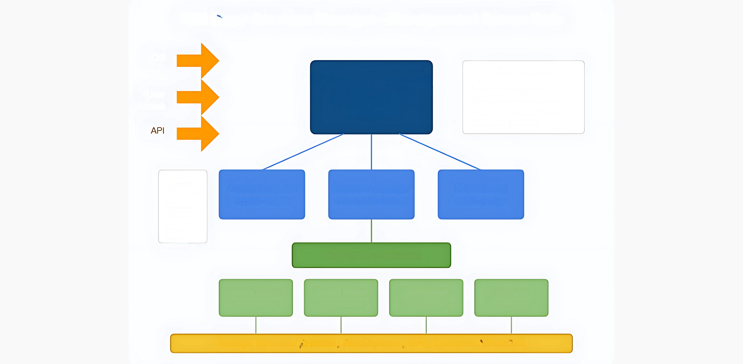
IBM Copy Services Manager - Management Server Role
CLI
Key Functions
CSM Management Serve
Central Control Point
for Replication
• Session Orchestration
• Configuration Management
• Role-based Access Control
• Automated Recovery
User
Access
API
Best
Practices
Authentication Access Control
Session Manager
Replication Control
Monitoring
Alerts & Logs
⚫ Dedicated HA server
⚫ Regular config
backups
Replication Sessions
Metro Mirror
Global Mirror
FlashCopy
Point-in-time
Custom
Multi-target
Synchronous
Asynchronous
Storage Systems (DS8000, Flash System, SVC, Spectrum Virtualize)
Notes:
This diagram illustrates the central role of the IBM Copy Services Manager (CSM) Management Server in controlling storage systems and replication sessions. Here's what the diagram shows:
Central Component
CSM Management Server serves as the central control point for all replication activities
Three access methods are shown: CLI, GUI (User Access), and API
Key Management Server Components
Authentication & Access Control
Manages user permissions and security
Implements role-based access control (RBAC)
Session Manager
Core component that controls replication processes
Orchestrates data movement between storage systems
Monitoring System
Provides alerts and logging capabilities
Tracks replication health and status
Replication Sessions
The diagram shows four types of replication that CSM manages:
Metro Mirror: Synchronous replication for zero data loss
Global Mirror: Asynchronous replication for longer distances
FlashCopy: Point-in-time copies for backups and testing
Custom: Multi-target replication configurations
Storage Systems
At the bottom, the diagram shows the supported IBM storage platforms:
DS8000
FlashSystem
SAN Volume Controller (SVC)
Spectrum Virtualize
Best Practices
The diagram also highlights key best practices:
Deploy CSM on dedicated high-availability servers
Perform regular configuration backups
This visualization helps explain how the management server functions as the orchestration hub that coordinates all replication activities between storage systems, providing centralized control, monitoring, and automation for enterprise data replication.
Would you like me to explain any aspect of this diagram in more detail or create another visualization focusing on a different aspect of IBM Copy Services Manager?

Slide 5
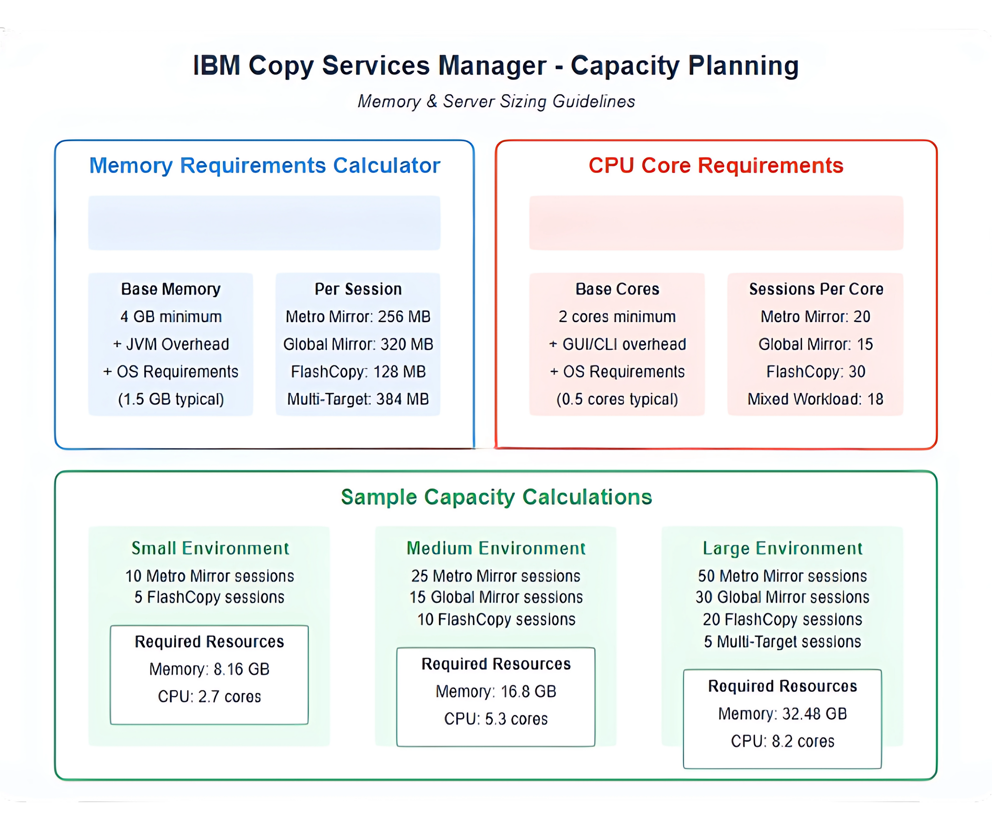
Base Memory +(Sessions x Memory Per Session)
Base Cores +(Sessions + Sessions Per Core)
Memory calculation: 4 GB + 1.5 GB + (SessiFbboacionare selfiðrchy) + (Session count+ Sessions per core)
Notes:
This diagram provides a visual guide for planning server capacity requirements for IBM Copy Services Manager deployments. Let me explain the key components:
Memory Requirements Calculator
The left upper section shows how to calculate memory needs:
Base Memory Formula: Base Memory + (Sessions × Memory Per Session)
Base Memory Components:
4 GB minimum for CSM
JVM overhead
OS requirements (typically 1.5 GB)
Memory Per Session varies by replication type:
Metro Mirror: 256 MB
Global Mirror: 320 MB
FlashCopy: 128 MB
Multi-Target configurations: 384 MB
CPU Core Requirements
The right upper section details CPU core calculations:
CPU Formula: Base Cores + (Sessions ÷ Sessions Per Core)
Base Core Components:
2 cores minimum for CSM
GUI/CLI overhead
OS requirements (typically 0.5 cores)
Sessions Per Core varies by workload type:
Metro Mirror: 20 sessions per core
Global Mirror: 15 sessions per core
FlashCopy: 30 sessions per core
Mixed workload: 18 sessions per core
Sample Calculations
The bottom section provides three example environments to demonstrate how the calculations work in practice:
Small Environment (10 Metro Mirror + 5 FlashCopy sessions):
Memory: 8.16 GB
CPU: 2.7 cores
Medium Environment (25 Metro Mirror + 15 Global Mirror + 10 FlashCopy sessions):
Memory: 16.8 GB
CPU: 5.3 cores
Large Environment (50 Metro Mirror + 30 Global Mirror + 20 FlashCopy + 5 Multi-Target sessions):
Memory: 32.48 GB
CPU: 8.2 cores
This visualization would be valuable for system administrators planning IBM CSM deployments as it provides clear guidelines for sizing servers appropriately based on the expected workload profile and number of replication sessions.
Would you like me to explain any specific calculation in more detail or create another visualization focusing on a different aspect of capacity planning for IBM CSM?RetryClaude can make mistakes. Please double-check responses. 3.7 SonnetChoose style1

Slide 6
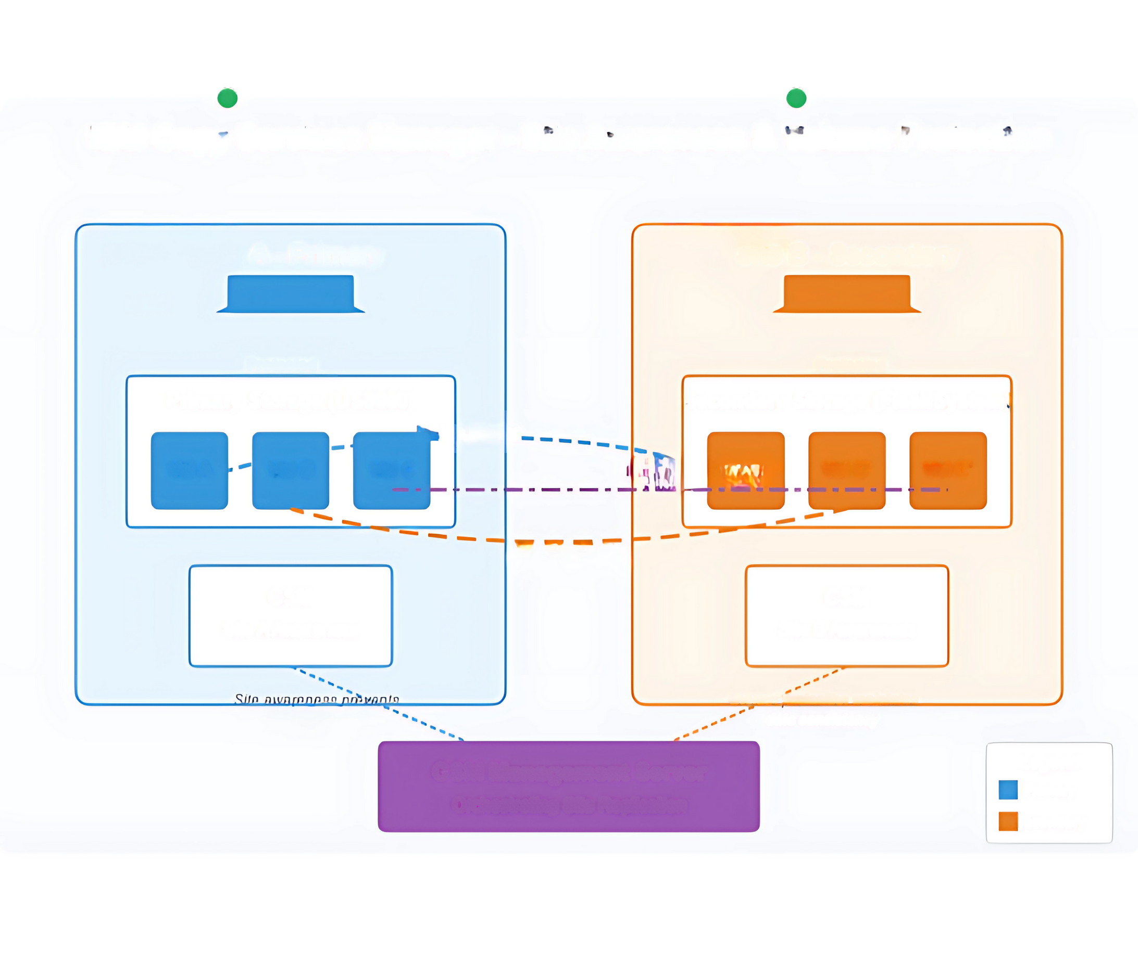
IBM Copy Services Manager - Site Awareness & Volume Protection
SITE A
SITE B
A - Primary
Site B- Secondary
Proloolod
Prolooled
Primary Storage (DS8000)
Secondary Storage (Flash System)
Metro Miror
Vol A
Vol B
Vol C
FlashCopy Vol A'
Vol B'
Vol C'
Global Mirror
CSM
CSM
Site A Awareness
Site B Awareness
Volum pmlection maintains
replication loops
dolo conoiolonoy
CSM Management Server
Legend
Orchestrating Site Replication
Primary
Secondary
Notes:
This diagram illustrates the concepts of site awareness and volume protection in IBM Copy Services Manager (CSM). Let me explain the key components:
Site Awareness
The diagram shows two geographically separated data centers:
Site A (Primary): Represented in blue on the left
Site B (Secondary): Represented in orange on the right
Each site has:
A unique Site ID (SITE_A and SITE_B) that CSM uses to identify locations
A local CSM component with site awareness configuration
Storage systems (DS8000 at Site A and FlashSystem at Site B)
Protected volumes that are part of replication relationships
Site awareness is a critical feature that:
Prevents replication loops where data might bounce back and forth between sites
Ensures that CSM knows which systems belong to which physical location
Helps maintain proper replication topologies in complex environments
Volume Protection
The diagram shows three different types of volume protection relationships:
Metro Mirror (synchronous replication)
Shown as a blue dashed line between Vol A and Vol A'
Provides real-time data mirroring with zero data loss
Typically used for critical applications requiring immediate recovery
Global Mirror (asynchronous replication)
Shown as an orange dashed line between Vol B and Vol B'
Used for longer distances where synchronous replication isn't feasible
Provides near-real-time protection with minimal impact on performance
FlashCopy (point-in-time copy)
Shown as a purple dashed line between Vol C and Vol C'
Creates instant snapshots for backups, testing, or data mining
Can be used in conjunction with mirrors for multi-layered protection
The central CSM Management Server at the bottom orchestrates all these replication relationships, maintaining awareness of site locations and ensuring proper volume protection across the enterprise.
The "Protected" status indicators show that volumes are currently in a protected state, meaning the replication is functioning correctly and data consistency is being maintained.
Would you like me to explain any specific aspect of site awareness or volume protection in more detail?

Slide 7
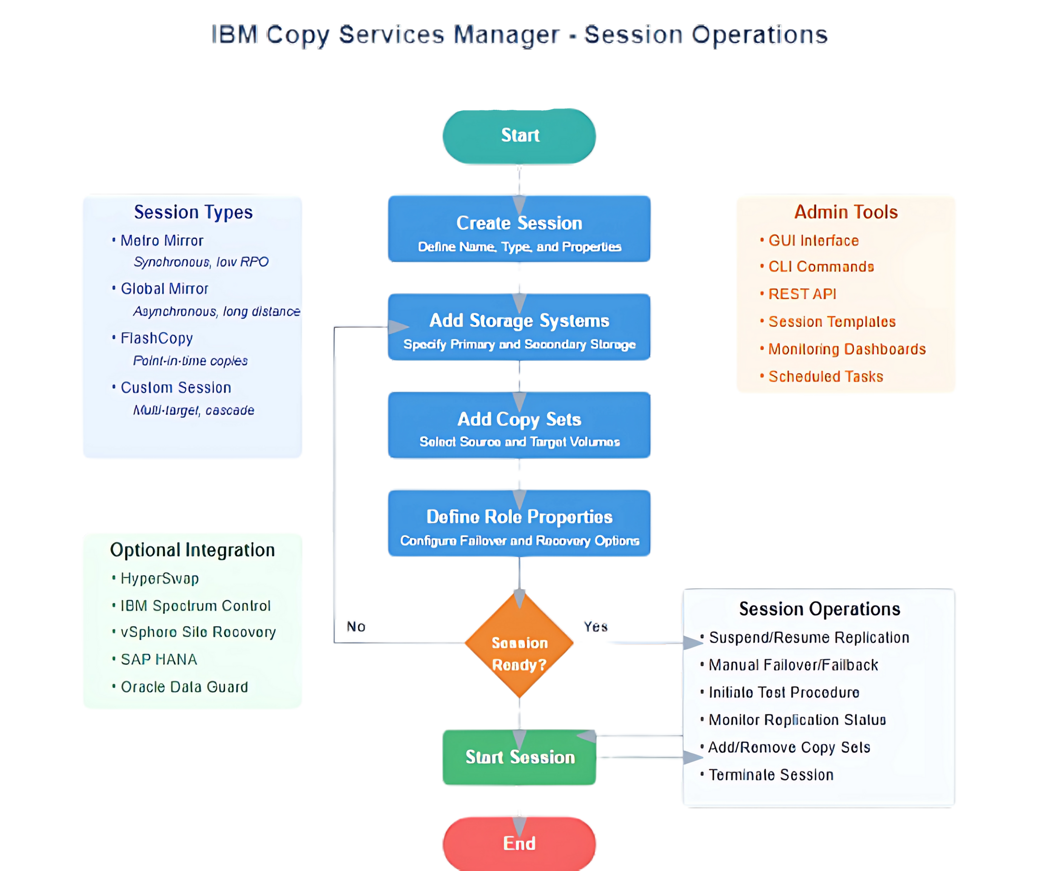
Notes:
This flowchart illustrates the key session operations in IBM Copy Services Manager (CSM), showing the workflow for managing replication sessions from creation to ongoing management.
Core Session Workflow
The main flowchart shows the sequential steps for managing replication sessions:
Create Session
Define the session name, type, and properties
Add Storage Systems
Specify the primary and secondary storage devices
Add Copy Sets
Select the source and target volumes to be replicated
Define Role Properties
Configure failover and recovery options for the session
Session Ready Decision Point
Verify if the session configuration is complete and correct
If not, return to earlier steps to make adjustments
Start Session
Initiate the replication process between storage systems
Session Operations
Once a session is active, administrators can perform various management operations:
Suspend/Resume Replication
Manual Failover/Failback
Initiate Test Procedure
Monitor Replication Status
Add/Remove Copy Sets
Terminate Session
Supporting Information
The diagram also provides contextual information about:
Session Types
Metro Mirror (synchronous, low RPO)
Global Mirror (asynchronous, long distance)
FlashCopy (point-in-time copies)
Custom Session (multi-target, cascade)
Admin Tools
GUI Interface
CLI Commands
REST API
Session Templates
Monitoring Dashboards
Scheduled Tasks
Optional Integration
HyperSwap
IBM Spectrum Control
vSphere Site Recovery
SAP HANA
Oracle Data Guard
This flowchart provides a comprehensive visual guide for administrators managing replication sessions in IBM Copy Services Manager, covering the entire lifecycle from creation through ongoing management.
Would you like me to explain any specific part of the session operations in more detail?

Slide 8
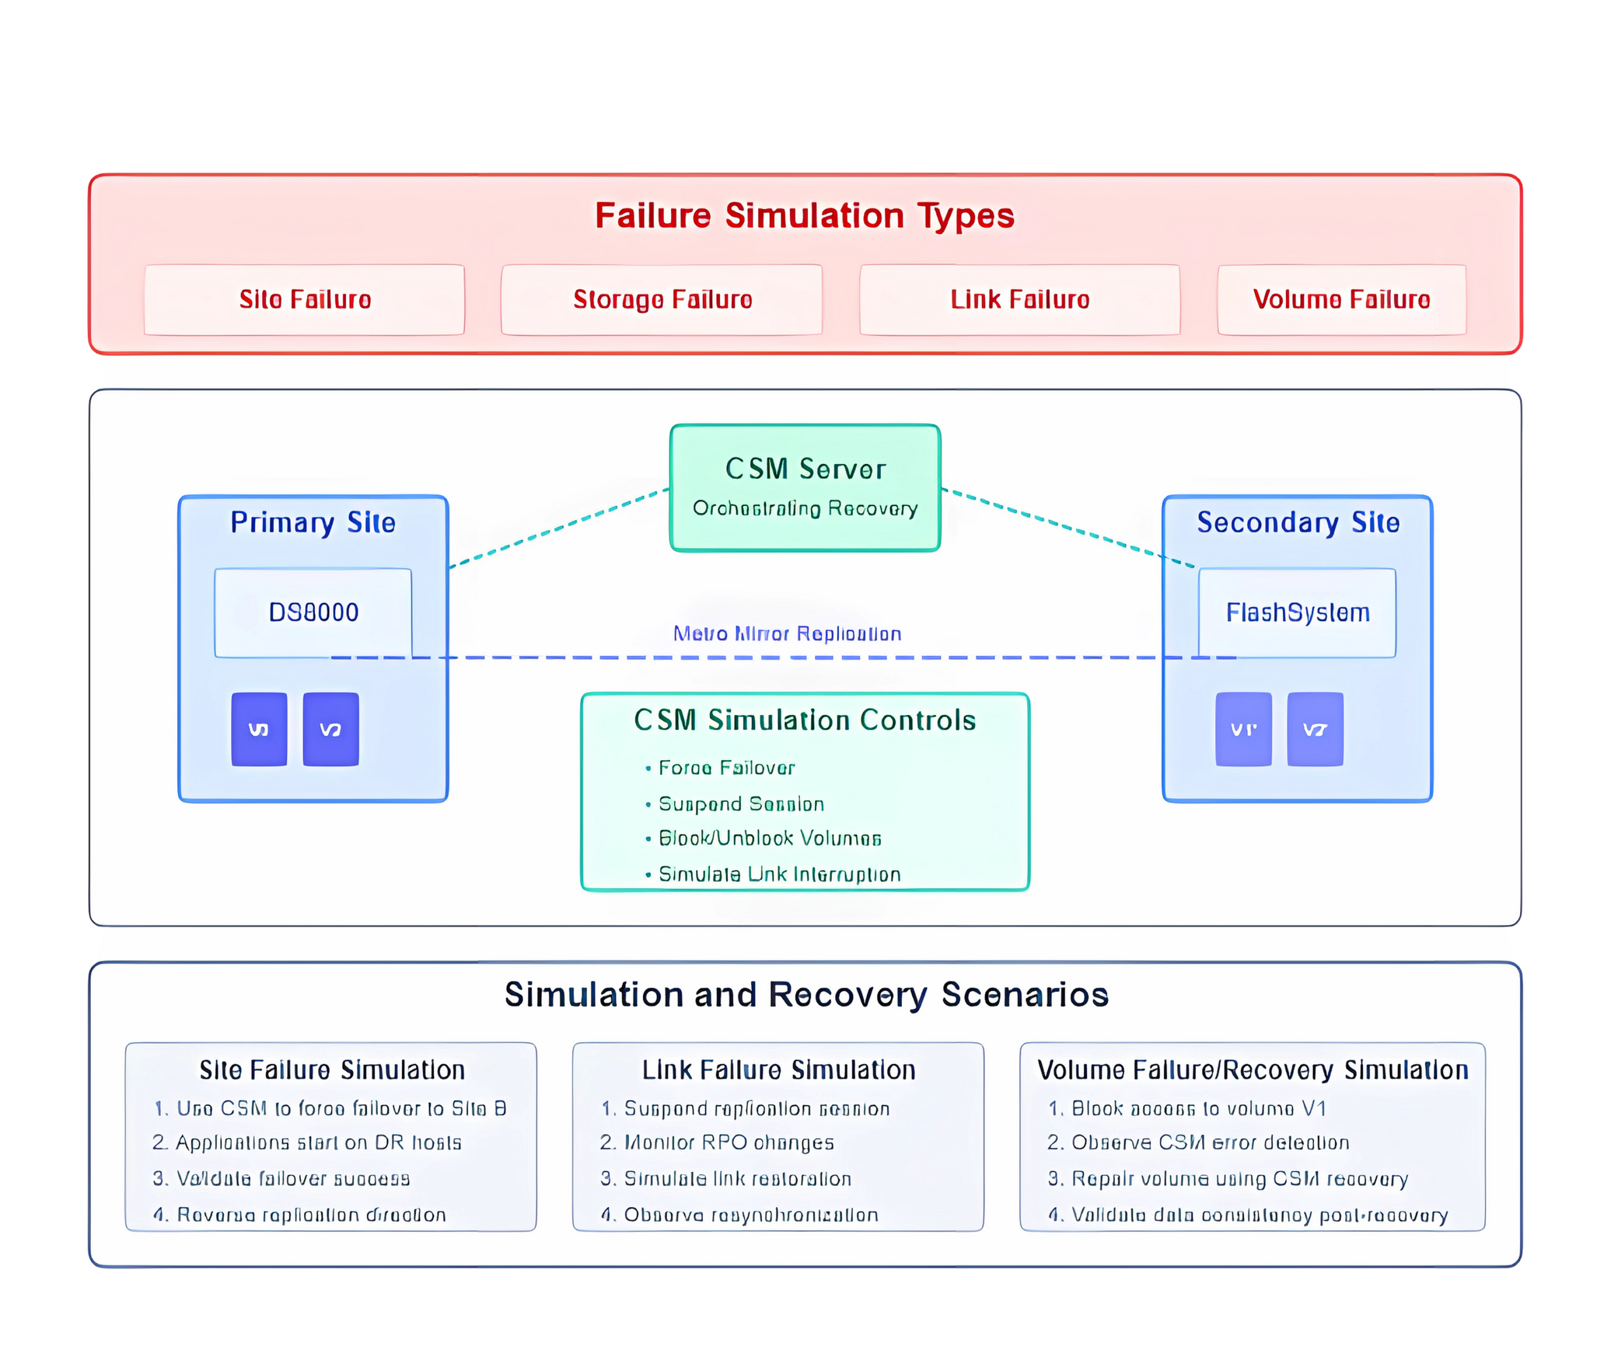
Notes:
I've created two diagrams to illustrate IBM Copy Services Manager's recovery testing and failure simulation capabilities.
Diagram 1: Recovery Testing Scenarios
The first diagram shows the structured approach to recovery testing in IBM CSM, focusing on:
Test Scenario Types
Application Test - For validating application functionality with replicated data
Disaster Recovery Test - For practicing complete recovery procedures
Integrity Validation Test - For verifying data consistency
The diagram details two main testing approaches:
Application Test Scenario
Step-by-step process for testing applications using FlashCopy of target volumes
Covers preparation, mounting test volumes, running application tests, and cleanup
Allows testing without disrupting production replication
DR Test Scenario
Complete process for simulating disaster recovery
Includes initiating test failover, activating DR systems, validating recovery, and documentation
Uses CSM's H1-Test procedure to create isolated test environment
The bottom section shows common CSM commands used during testing, including startH1test, stopH1test, and mktest.
Diagram 2: Failure Simulation and Recovery
The second diagram illustrates how CSM can simulate various failure scenarios and orchestrate recovery:
Failure Simulation Types
Site Failure - Complete loss of a data center
Storage Failure - Storage system malfunction
Link Failure - Network connectivity issues between sites
Volume Failure - Individual volume corruption or loss
The central diagram shows:
Primary and secondary sites with their respective storage systems
Volume relationships between sites
CSM server orchestrating replication and recovery
Animated replication paths showing data flow
The CSM Simulation Controls section shows the key functions used to simulate failures:
Force Failover
Suspend Session
Block/Unblock Volumes
Simulate Link Interruption
Finally, the diagram details three specific simulation scenarios:
Site Failure Simulation - Testing complete site failover
Link Failure Simulation - Testing network interruption and resynchronization
Volume Failure/Recovery Simulation - Testing individual volume recovery

Slide 9
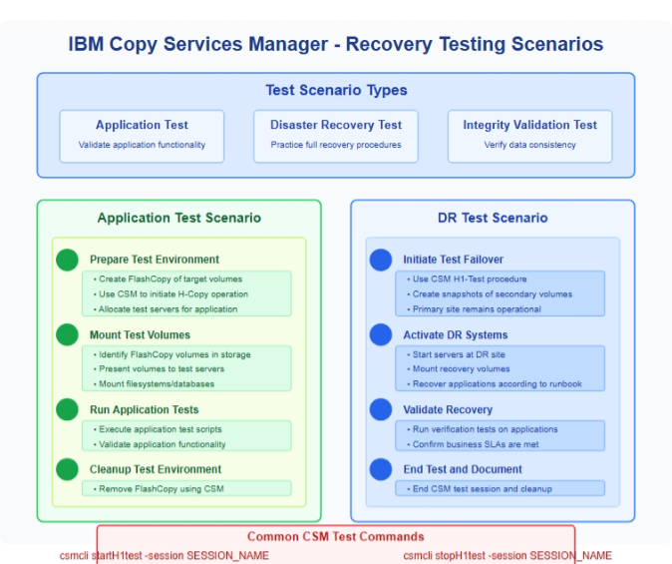
Notes:
I've created two diagrams to illustrate IBM Copy Services Manager's recovery testing and failure simulation capabilities.
Diagram 1: Recovery Testing Scenarios
The first diagram shows the structured approach to recovery testing in IBM CSM, focusing on:
Test Scenario Types
Application Test - For validating application functionality with replicated data
Disaster Recovery Test - For practicing complete recovery procedures
Integrity Validation Test - For verifying data consistency
The diagram details two main testing approaches:
Application Test Scenario
Step-by-step process for testing applications using FlashCopy of target volumes
Covers preparation, mounting test volumes, running application tests, and cleanup
Allows testing without disrupting production replication
DR Test Scenario
Complete process for simulating disaster recovery
Includes initiating test failover, activating DR systems, validating recovery, and documentation
Uses CSM's H1-Test procedure to create isolated test environment
The bottom section shows common CSM commands used during testing, including startH1test, stopH1test, and mktest.
Diagram 2: Failure Simulation and Recovery
The second diagram illustrates how CSM can simulate various failure scenarios and orchestrate recovery:
Failure Simulation Types
Site Failure - Complete loss of a data center
Storage Failure - Storage system malfunction
Link Failure - Network connectivity issues between sites
Volume Failure - Individual volume corruption or loss
The central diagram shows:
Primary and secondary sites with their respective storage systems
Volume relationships between sites
CSM server orchestrating replication and recovery
Animated replication paths showing data flow
The CSM Simulation Controls section shows the key functions used to simulate failures:
Force Failover
Suspend Session
Block/Unblock Volumes
Simulate Link Interruption
Finally, the diagram details three specific simulation scenarios:
Site Failure Simulation - Testing complete site failover
Link Failure Simulation - Testing network interruption and resynchronization
Volume Failure/Recovery Simulation - Testing individual volume recovery

